Slide 1

Using MLflow for Experiment Tracking and Model Management

Slide 2
About MLFLow
MLFlow: Unified Platform for Experiment Tracking and Model Registry
MLflow is an open-source platform for managing the end-to-end machine learning lifecycle. It provides a suite of tools and components designed to streamline the development, experimentation, productionization, and collaboration aspects of machine learning projects. MLflow is widely used by data scientists, machine learning engineers, and researchers to track experiments, package and share code, and deploy models at scale.

Slide 3
Introduction to Experiment Tracking
Why Track?
Organization
Optimization
Reproducibility
What do you want to track for each Experiment Run?
Training and Validation Data Used
Hyper parameters
Metrics
Models
Training Time
Model Size
Tool - MLFlow
MLFlow helps you to organize your experiments into runs.

Slide 4
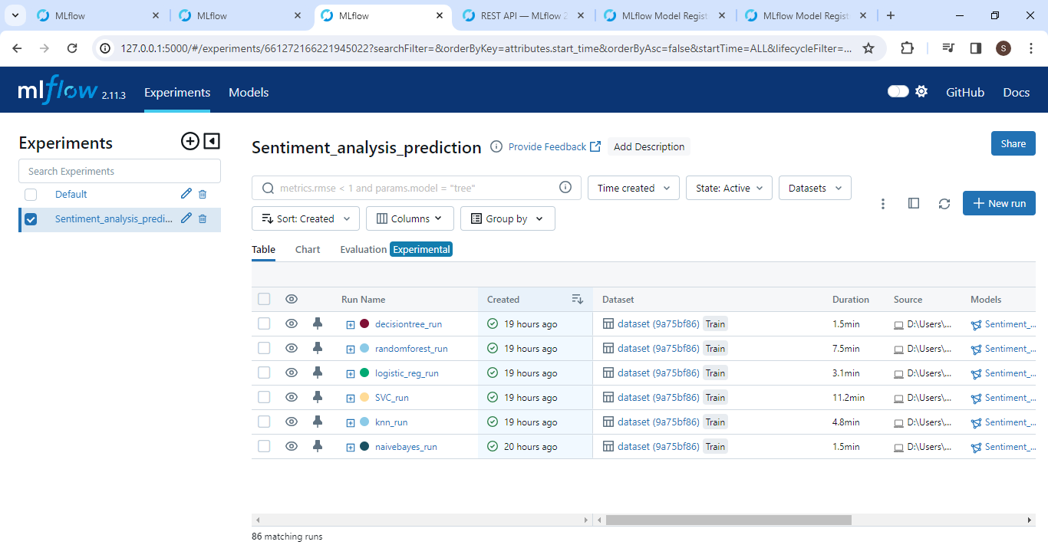
Customizing MLflow UI with run names

Slide 5
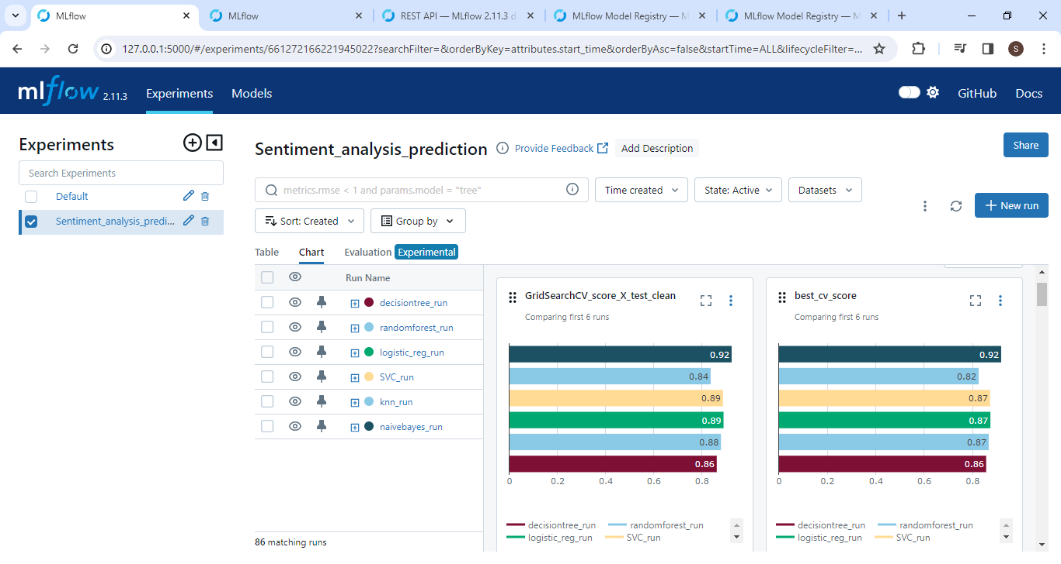
Demonstrating metric plots.

Slide 6
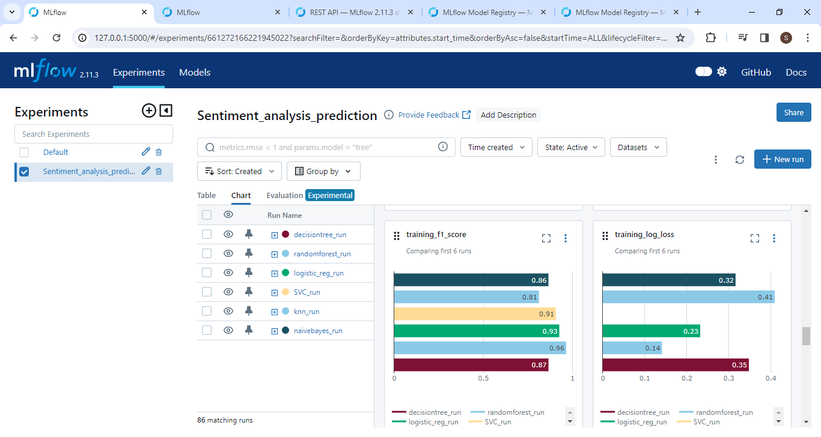

Slide 7
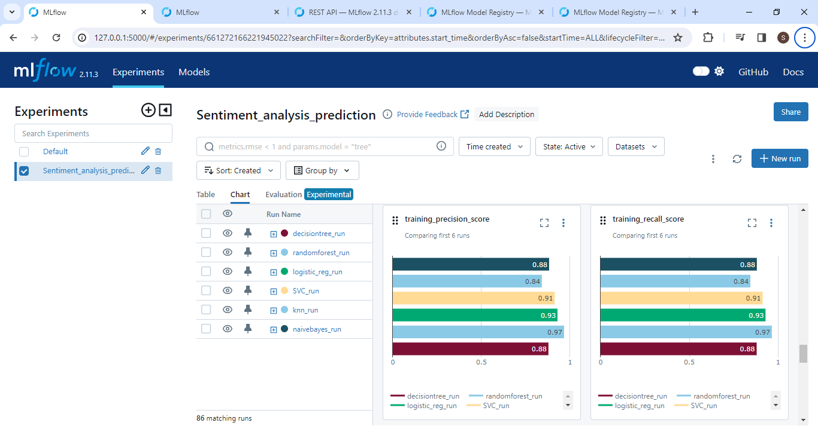

Slide 8
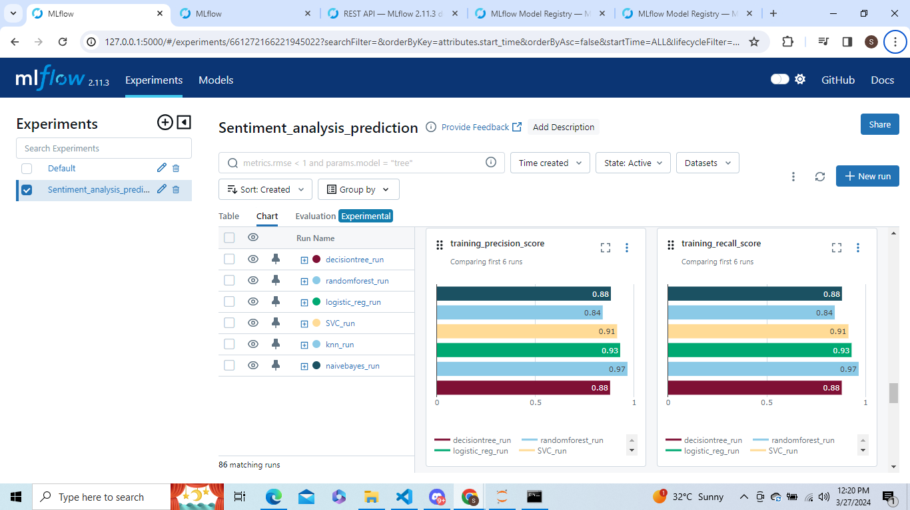

Slide 9
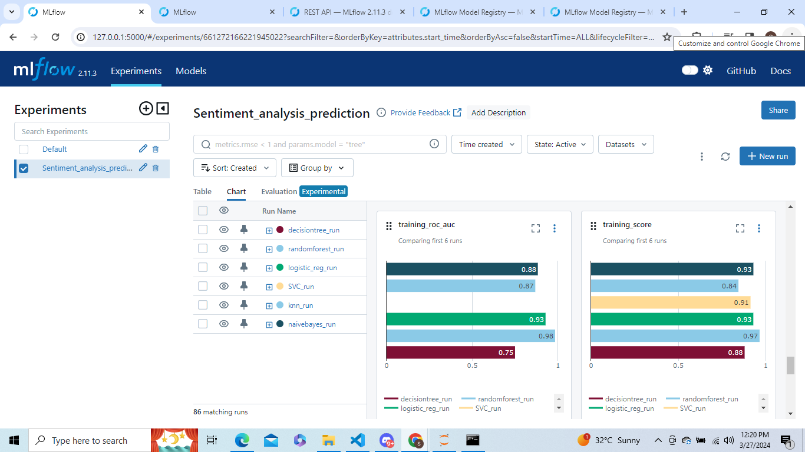

Slide 10
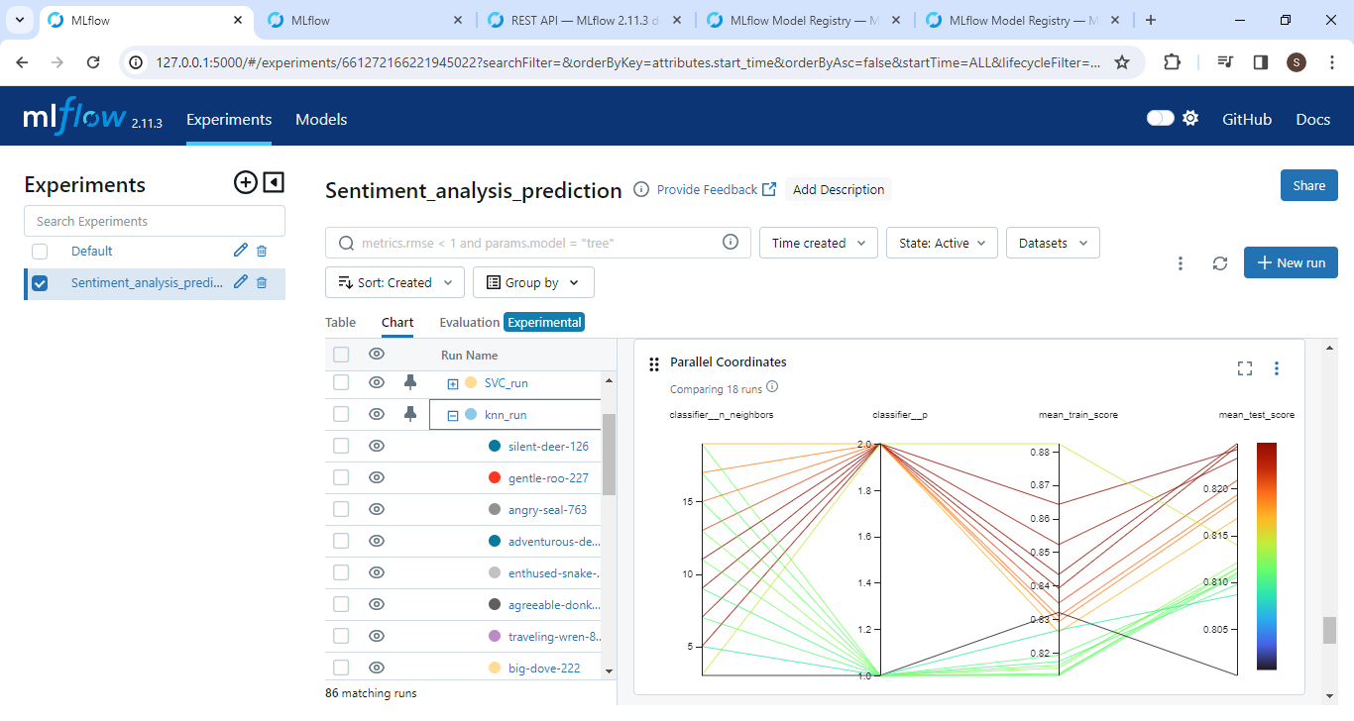
Demonstrating hyper parameter plots.

Slide 11
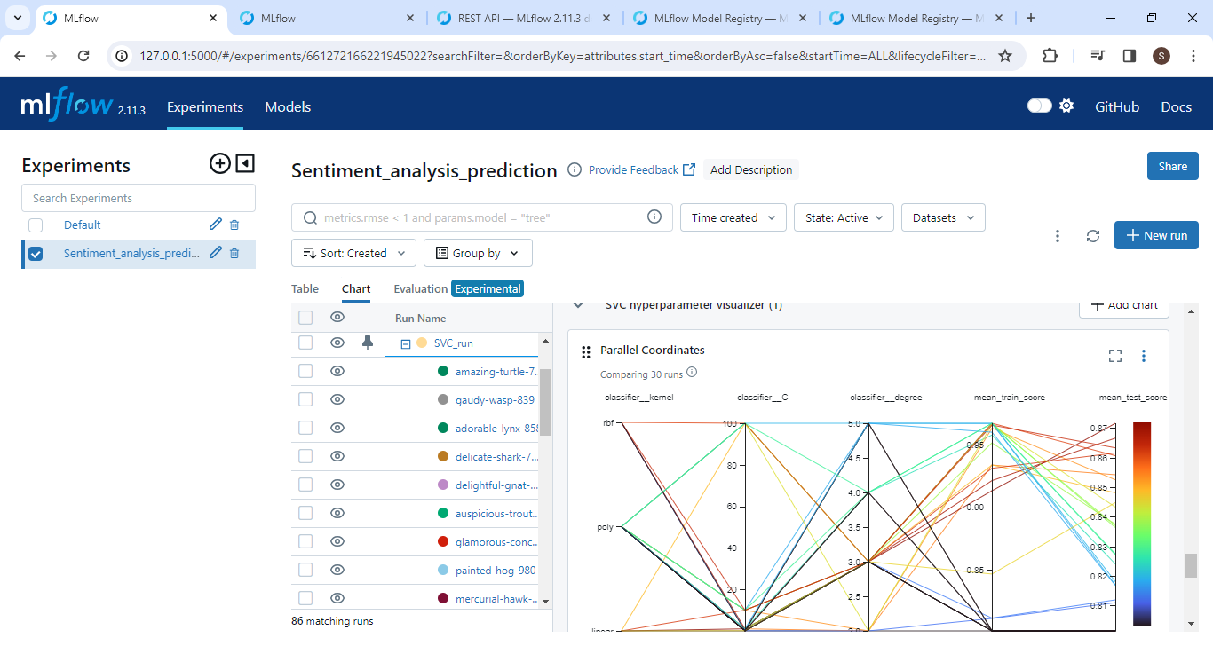

Slide 12
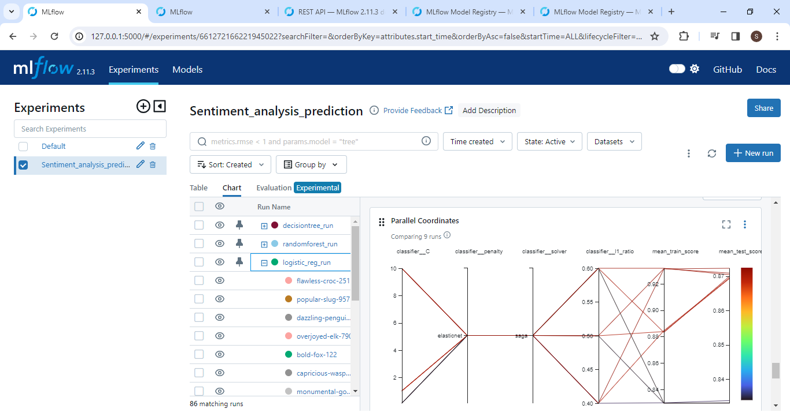

Slide 13
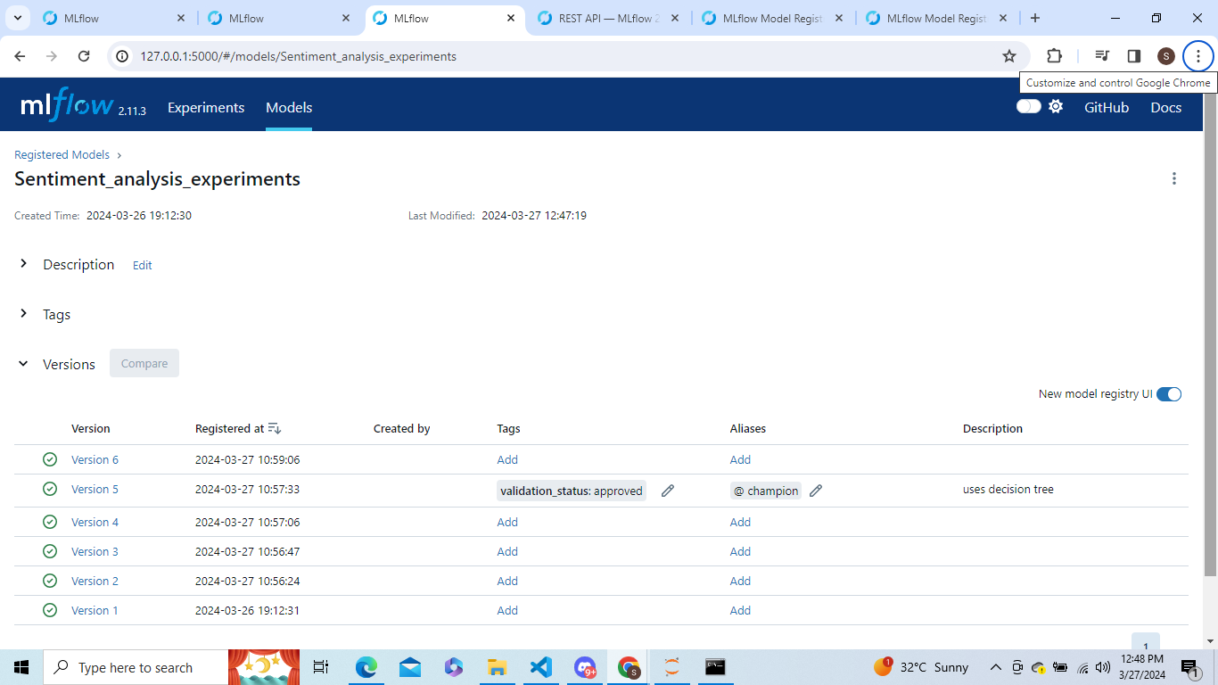
Registering Models and managing by taging them

Slide 14
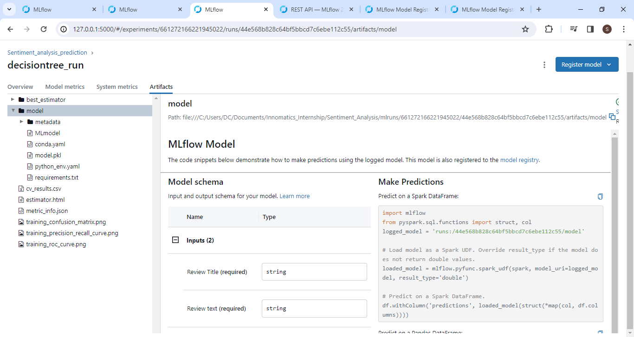

Slide 15
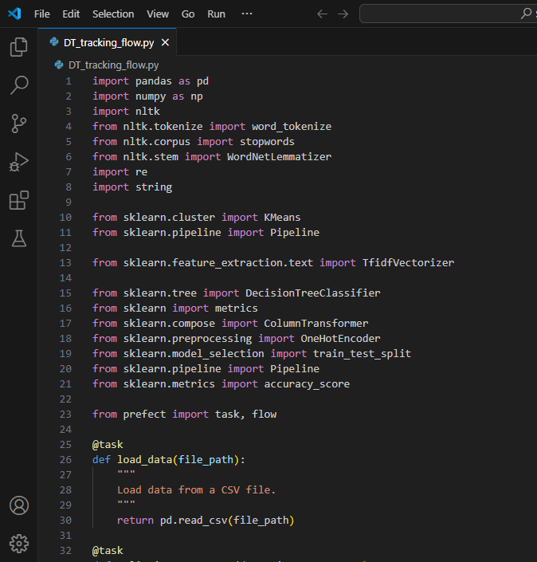
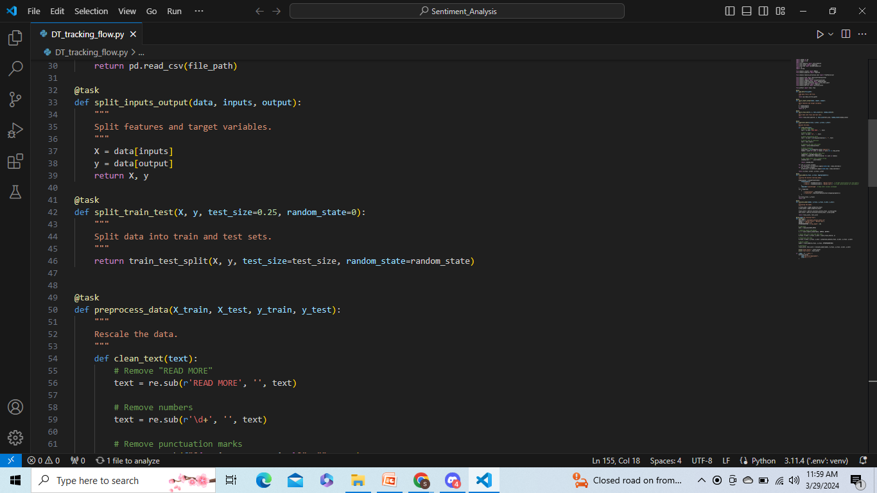
Building a Prefect Workflow and Auto Scheduling it.

Slide 16
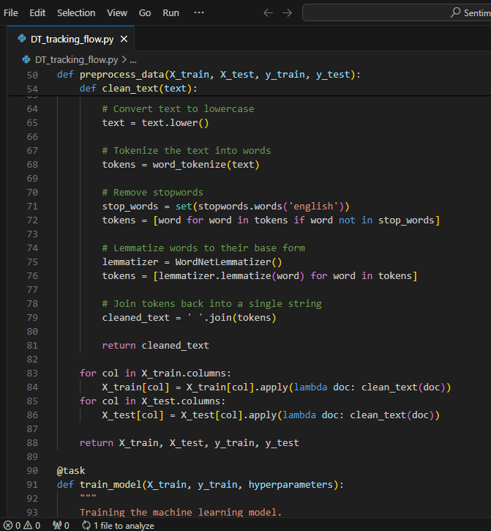
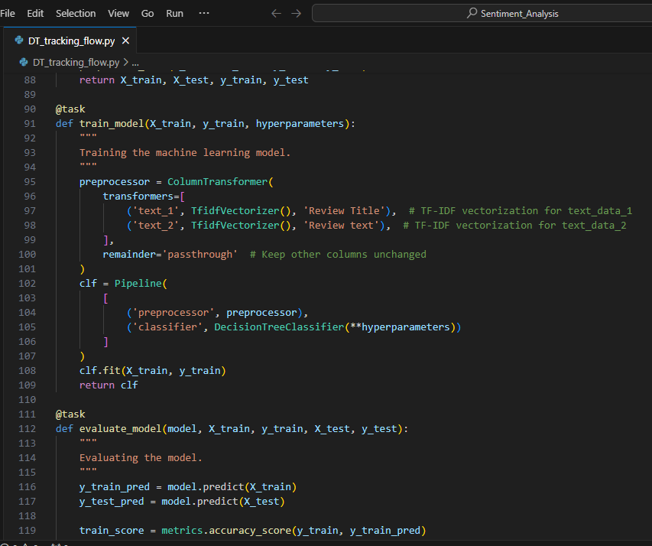

Slide 17
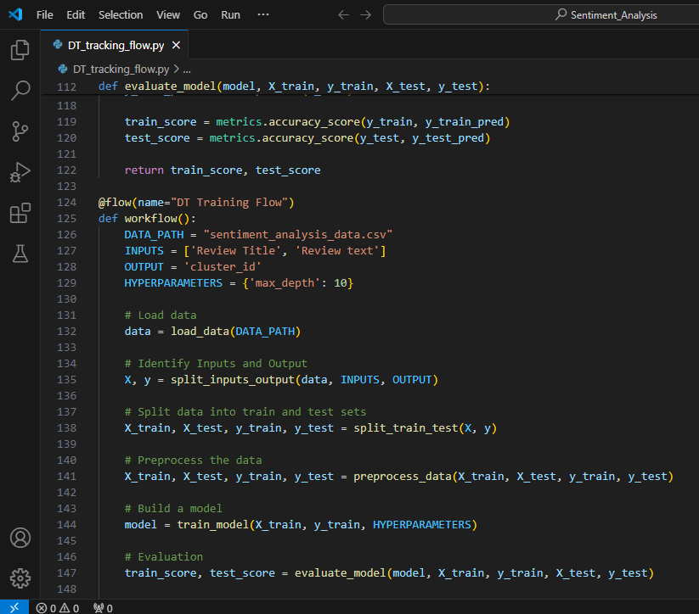
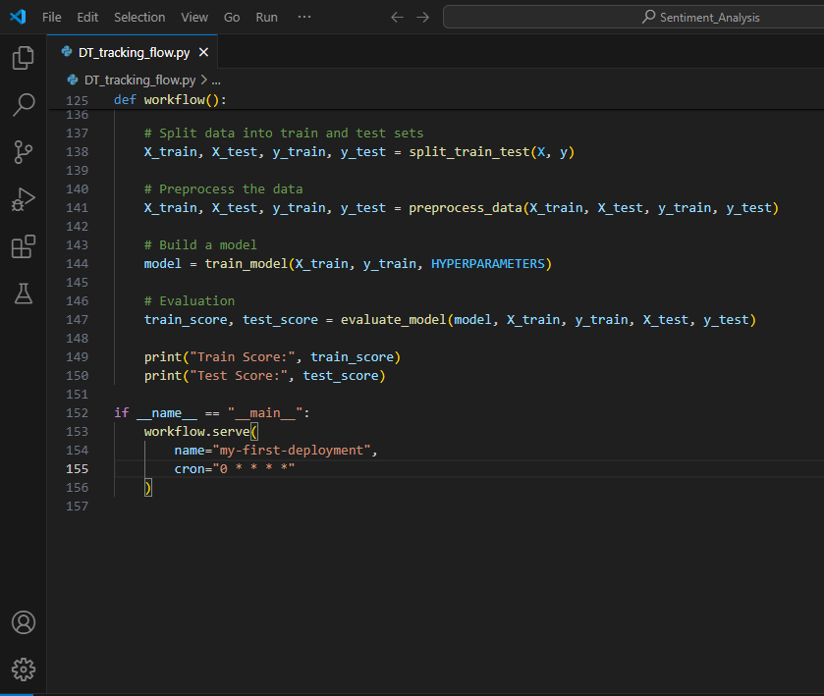

Slide 18
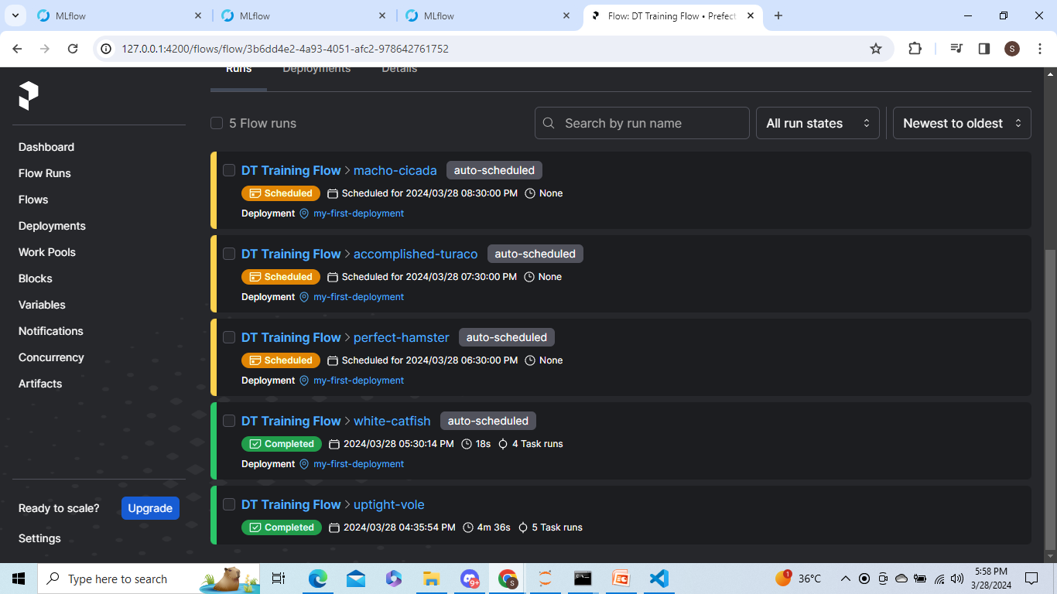
The Prefect Dashboard with relevant outputs.

Slide 19
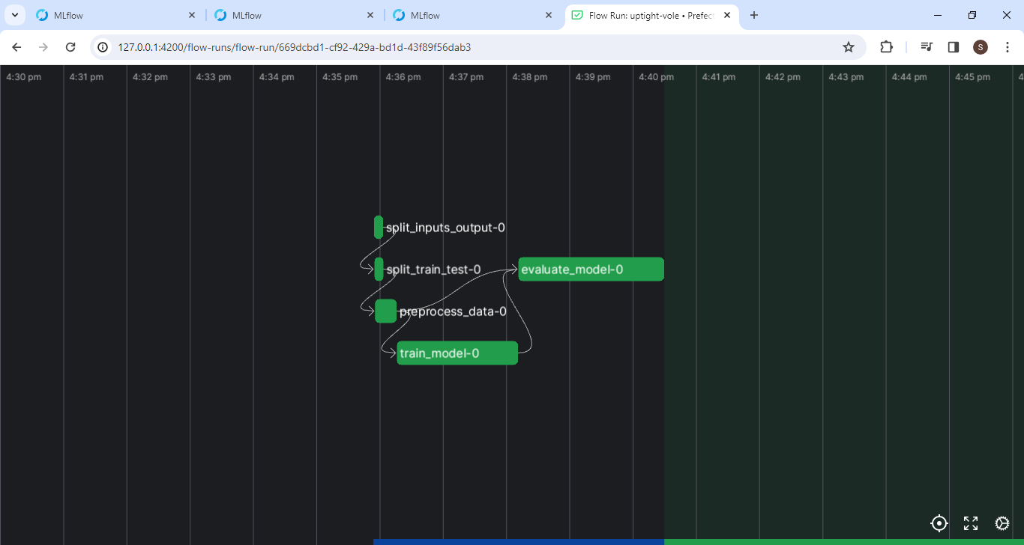

Slide 20

THANK YOU

